Slide 1
CSE 3400 - Introduction to Computer & Network Security (aka: Introduction to Cybersecurity) Lecture 9 Shared Key Protocols – Part II
Ghada Almashaqbeh
UConn
From Textbook Slides by Prof. Amir Herzberg
UConn

Slide 2
Outline
Handshake protocol extensions.
Key distribution centers.
Improving resilience to key exposure.
2

Slide 3
Handshake Protocols Extensions
3

Slide 4
Authenticated Request-Response Protocols
Beside authenticating entities, these protocols authenticate the exchange of a request and a response between the entities.
Required properties:
Request authentication.
The request was indeed sent by the peer.
Response authentication
The response was indeed sent by the peer.
No replay.
Every request/response was received at most the number of times it was sent by the peer.
4

Slide 5
Authenticated Request-Response Protocols
Five variants:
2PP-RR
2RT-2PP
Counter-based-RR
Time-based-RR.
Key-exchange.
5

Slide 6
2PP-RR
A three-flow nonce-based protocol.
Significant drawback:
The request is sent by the responder and the initiator sends the response.
So initiator must wait for a request rather than sending it!!
6
Notes:
6
(c) Amir Herzberg, http://AmirHerzberg.com, Bar Ilan University
11/13/11

Slide 7
2RT-2PP
A four-flow nonce-based protocol.
Mainly fixes the drawback of 2PP-RR (see previous slide).
7
Notes:
7
(c) Amir Herzberg, http://AmirHerzberg.com, Bar Ilan University
11/13/11

Slide 8
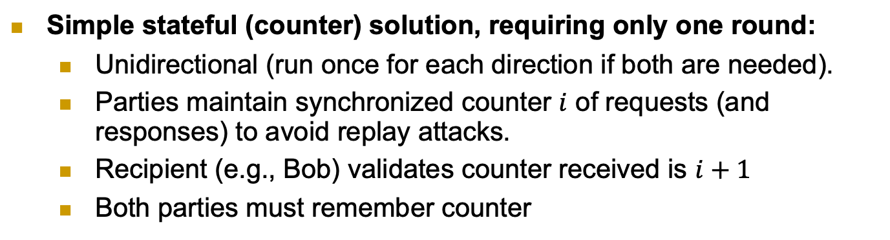
Counter-Based Authenticated RR
Simple stateful (counter) solution, requiring only one round:
Unidirectional (run once for each direction if both are needed).
Parties maintain synchronized counter $i$ of requests (and responses) to avoid replay attacks.
Recipient (e.g., Bob) validates counter received is $i+1$
Both parties must remember counter
8
Notes:
8
(c) Amir Herzberg, http://AmirHerzberg.com, Bar Ilan University
11/13/11

Slide 9
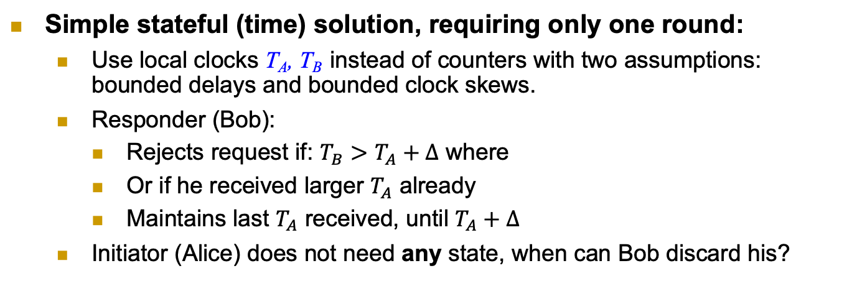
Time-Based Authenticated RR
Simple stateful (time) solution, requiring only one round:
Use local clocks T_{A}, T_{B} instead of counters with two assumptions: bounded delays and bounded clock skews.
Responder (Bob):
Rejects request if: $T_{B}>T_{A}+Δ$ where
Or if he received larger $T_{A}$ already
Maintains last $T_{A}$ received, until $T_{A}+Δ$
Initiator (Alice) does not need any state, when can Bob discard his?
Remember T_{A}
9
Notes:
9
(c) Amir Herzberg, http://AmirHerzberg.com, Bar Ilan University
11/13/11

Slide 10
2RT-2PP with Confidentiality
Secure connection: authentication, freshness, secrecy
Independent keys: for encryption k.e, for authentication: k.a
How can we derive them both from a single key k ?
k.e=PRP_{k}(“Encrypt”), k.a=PRP_{k}(“MAC”)
Hmm… same key encrypts all messages, in all sessions ☹
Can we improve security, by changing keys, e.g., btw sessions ?
Alice
Bob
A, N_{A}
N_{B}
E_{k.e}(req) , Mac_{k.a}(3 || A→B || N_{A} || N_{B} || E_{k.e}(req) )
E_{k.e}(resp) , Mac_{k.a}(4 || A←B ||N_{A} || N_{B} || E_{k.e}(resp))
10
Notes:
10
(c) Amir Herzberg, http://AmirHerzberg.com, Bar Ilan University
11/13/11

Slide 11
2PP Key Exchange Protocol
Independent session keys, e.g. k=PRF_{MK}(N_{A},N_{B})
Or, `directly’ for authentication and for encryption: k.e=PRF_{MK}(“Encrypt”, N_{A},N_{B}), k.a=PRF_{MK}(“MAC”, N_{A},N_{B})
Improves security:
Exposure of session key does not expose (long-term) ‘master key’ MK
And does not expose keys of other sessions
Limited amount of ciphertext exposed with each session key k
Later: reduce risk also from exposure of Master Key MK
Why a PRF is used instead of the MAC as before?
11
Notes:
11
(c) Amir Herzberg, http://AmirHerzberg.com, Bar Ilan University
11/13/11

Slide 12
Key Distribution Centers (KDCs) Establish a shared key between two or more entities, usually with the help of a trusted third party referred to as KDC
12

Slide 13
Key Distribution Center (KDC)
Will focus on three party protocols; Alice, Bob, and KDC.
KDC: shares keys with all parties (k_{A}, k_{B}…)
Goal: help parties (A, B) establish k_{AB}
We will study two protocols; simplified versions of:
The Kerberos protocol (secure) widely used in computer networks.
The GSM protocol (insecure) used by cellular networks.
13
Notes:
KDC = TGS (Ticket Granting Server) [Kerberos]

Slide 14
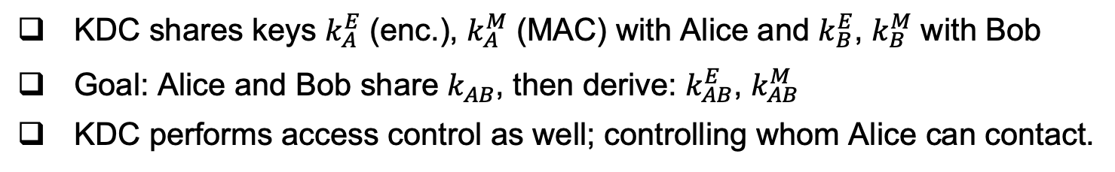
The Kerberos KDC Protocol
KDC shares keys $k_{A}^{E}$ (enc.), $k_{A}^{M}$ (MAC) with Alice and $k_{B}^{E}$, $k_{B}^{M}$ with Bob
Goal: Alice and Bob share $k_{AB}^{}$, then derive: $k_{AB}^{E}$, $k_{AB}^{M}$
KDC performs access control as well; controlling whom Alice can contact.
14

Slide 15
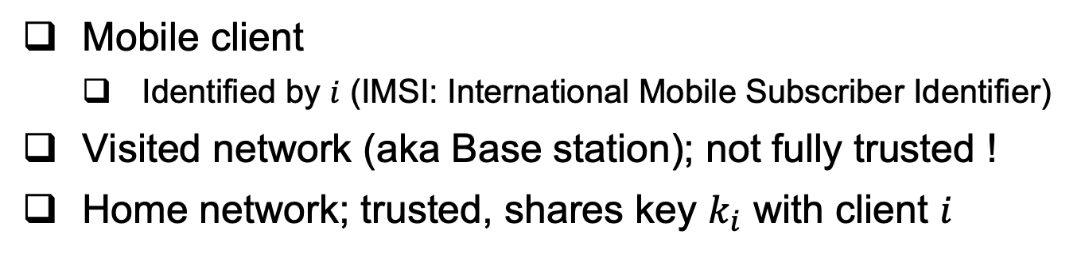
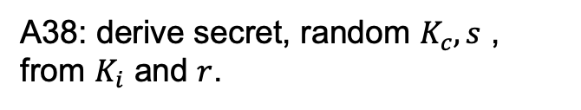
The GSM Handshake Protocol
Mobile client
Identified by $i$ (IMSI: International Mobile Subscriber Identifier)
Visited network (aka Base station); not fully trusted !
Home network; trusted, shares key $k_{i}$ with client $i$
A38: derive secret, random $K_{c}, s$ , from $K_{i}$ and $r$.
GSM spec: OWF, but really should be a PRF!
15

Slide 16
Example – Sending two messages
Kc is the session key
s is called a secret authenticator
A5: provide ‘pad’ for encryption
Several variants: A5/1 - `regular’
A5/2 - `weak’
A5/3 – more secure
Really should be a PRF!
ECC: error correcting code. Used to allow recovery from errors.
16

Slide 17
Attacks on GSM
We will explore two such attacks:
Visited network impersonation replay attack.
Downgrade attack.
17
Notes:
KDC = TGS (Ticket Granting Server) [Kerberos]

Slide 18
Visited-network Impersonation Attack
Note: does NOT
Impersonate mobile, only Visited network.
In the cryptanalysis phase, the attacker will try to obtain Kc based on the cyphertexts it collected in the eavesdropping phase (recall A5/1 and A5/2 are not secure)
18

Slide 19
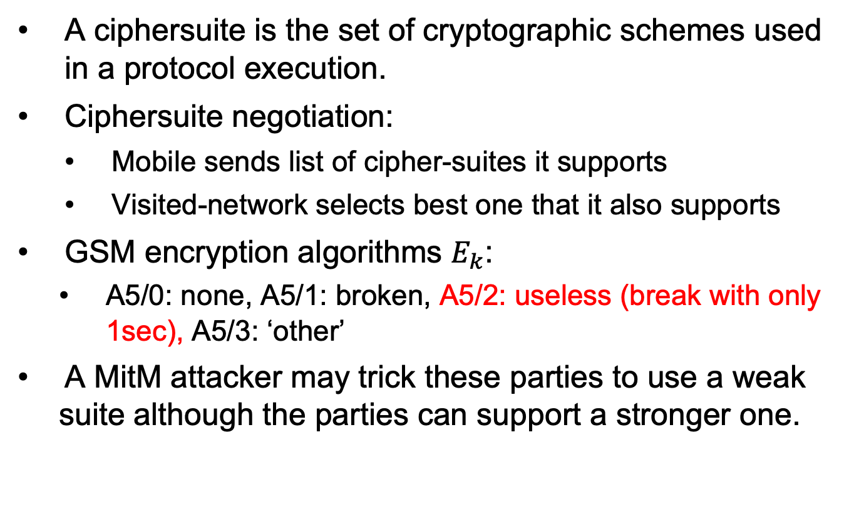
GSM Ciphersuites Downgrade Attack
A ciphersuite is the set of cryptographic schemes used in a protocol execution.
Ciphersuite negotiation:
Mobile sends list of cipher-suites it supports
Visited-network selects best one that it also supports
GSM encryption algorithms $E_{k}$:
A5/0: none, A5/1: broken, A5/2: useless (break with only 1sec), A5/3: ‘other’
A MitM attacker may trick these parties to use a weak suite although the parties can support a stronger one.
19

Slide 20
Cipher mode messages, negotiation
Mobile sends list of supported ciphers
VN sends choice in: CIPHMODCMD
Cipher Mode Command
Mobile confirms by sending encrypted: CIPHMODCOM: cipher mode complete
If not received (in few msecs), VN disconnects
VN Acks: CIPHMODOK: cipher mode Ok
If not received, mobile resends CIPHMODCOM
Details in the textbook
20

Slide 21
Improving Resiliency to Key Exposure
21

Slide 22
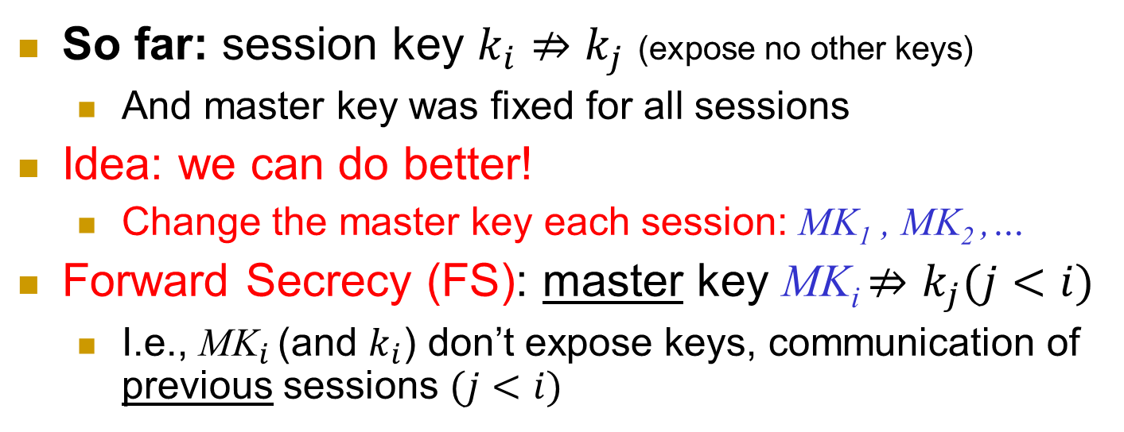
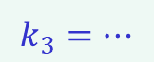
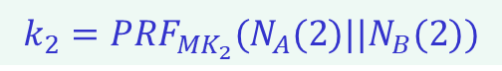
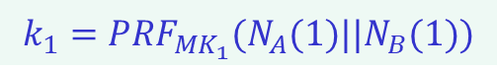
Forward Secrecy I
So far: session key $k_{i}⇏k_{j}$ (expose no other keys)
And master key was fixed for all sessions
Idea: we can do better!
Change the master key each session: MK₁ , MK₂ ,…
Forward Secrecy (FS): master key MK_{i} $⇏k_{j}(j<i)$
I.e., ${\text{MK}}_{i}$ (and $k_{i}$) don’t expose keys, communication of previous sessions $(j<i)$
Secure MK₁
Keys Exposed
MK₂
Stays insecure
MK₃
$$k_{1}={PRF}_{{MK}_{1}}(N_{A}(1)||N_{B}(1))$$
$$k_{2}={PRF}_{{MK}_{2}}(N_{A}(2)||N_{B}(2))$$
$$k_{3}=…$$
22
Notes:
22
(c) Amir Herzberg, http://AmirHerzberg.com, Bar Ilan University
11/13/11
`Perfect’ is not really the right term… but that’s the commonly used term.

Slide 23

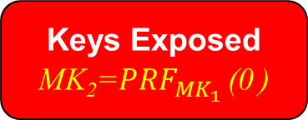
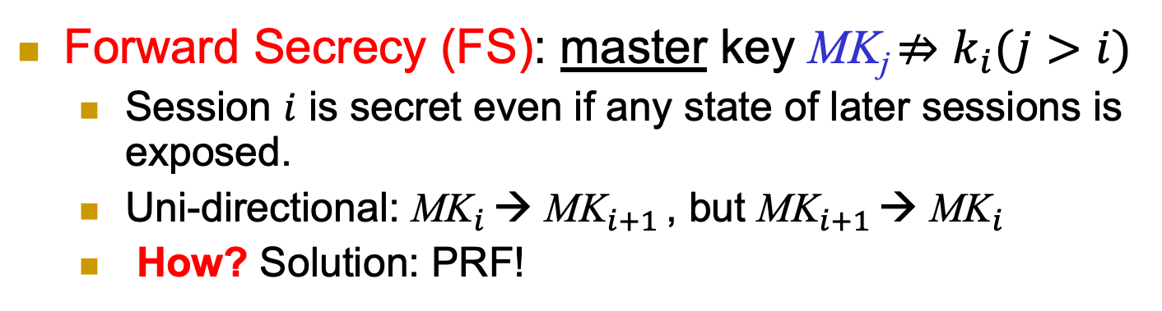
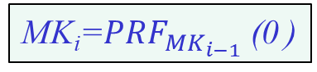
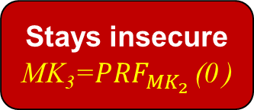
Forward Secrecy II
Forward Secrecy (FS): master key MK_{j} $⇏k_{i}(j>i)$
Session $i$ is secret even if any state of later sessions is exposed.
Uni-directional: ${\text{MK}}_{i}$ → ${\text{MK}}_{i+1}$ , but ${\text{MK}}_{i+1}$ → ${\text{MK}}_{i}$
How? Solution: PRF!
MK_{i}=${PRF}_{{MK}_{i−1}}$ (0 )
Secure MK₁
Keys Exposed
MK₂=${PRF}_{{MK}_{1}}$ (0 )
Stays insecure
MK₃=${PRF}_{{MK}_{2}}$ (0 )
$$k_{1}={PRF}_{{MK}_{1}}(N_{A}(1)||N_{B}(1))$$
$$k_{2}={PRF}_{{MK}_{2}}(N_{A}(2)||N_{B}(2))$$
$$k_{3}=…$$
23
Notes:
23
(c) Amir Herzberg, http://AmirHerzberg.com, Bar Ilan University
11/13/11
`Perfect’ is not really the right term… but that’s the commonly used term.

Slide 24
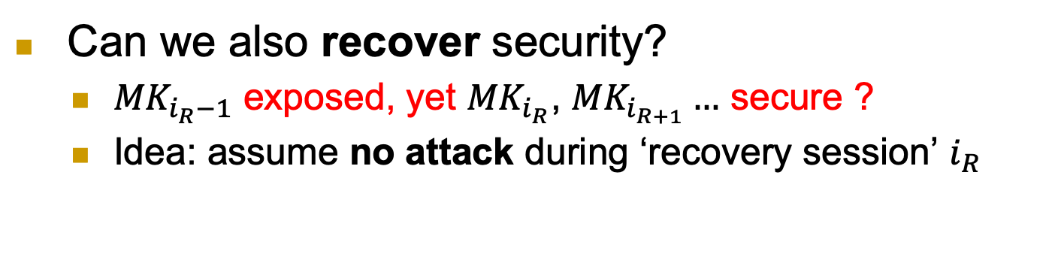
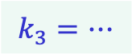
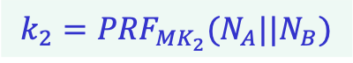
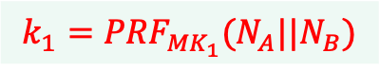
Recover Security
Can we also recover security?
${MK}_{i_{R}−1}$ exposed, yet ${MK}_{i_{R}}$, ${MK}_{i_{R+1}}…$ secure ?
Idea: assume no attack during ‘recovery session’ $i_{R}$
Keys Exposed
MK₁
No attack: recover !
MK₂
Stays secure
MK₃
$$k_{1}={PRF}_{{MK}_{1}}(N_{A}||N_{B})$$
$$k_{2}={PRF}_{{MK}_{2}}(N_{A}||N_{B})$$
$$k_{3}=…$$
24
Notes:
24
(c) Amir Herzberg, http://AmirHerzberg.com, Bar Ilan University
11/13/11
`Perfect’ is not really the right term… but that’s the commonly used term.

Slide 25

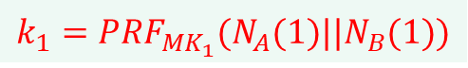
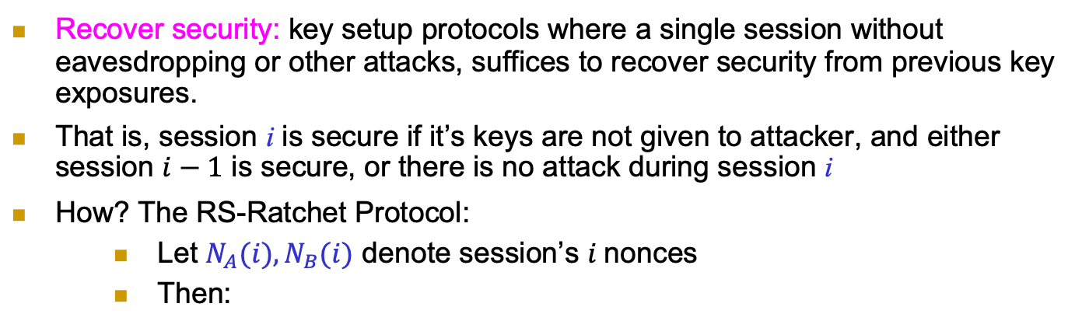
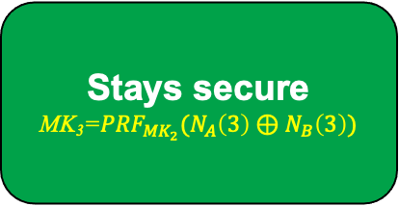
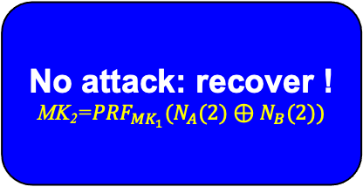
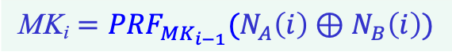

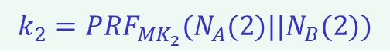
Recover Security (RS)
Recover security: key setup protocols where a single session without eavesdropping or other attacks, suffices to recover security from previous key exposures.
That is, session i is secure if it’s keys are not given to attacker, and either session $i−1$ is secure, or there is no attack during session i
How? The RS-Ratchet Protocol:
Let $N_{A}(i), N_{B}(i)$ denote session’s $i$nonces
Then:
$$\text{MK}\text{i}={PRF}_{{MK}_{i−1}}(N_{A}\left(i\right)⊕N_{B}\left(i\right))$$
Keys Exposed
MK₁
No attack: recover !
MK₂=${PRF}_{{MK}_{1}}(N_{A}(2)⊕N_{B}(2))$
Stays secure
MK₃=${PRF}_{{MK}_{2}}(N_{A}\left(3\right)⊕N_{B}\left(3\right))$
$$k_{1}={PRF}_{{MK}_{1}}(N_{A}(1)||N_{B}(1))$$
$$k_{2}={PRF}_{{MK}_{2}}(N_{A}(2)||N_{B}(2))$$
$$k_{3}=…$$
25
Notes:
25
(c) Amir Herzberg, http://AmirHerzberg.com, Bar Ilan University
11/13/11
`Perfect’ is not really the right term… but that’s the commonly used term.

Slide 26
Covered Material From the Textbook
Chapter 5
Sections 5.3 – 5.7 (except 5.7.3)

Slide 27

Thank You!

